Slide 1
ESF to RSF: Everyone has a Recovery Function
Fall Forum 2016
Michelle Oblinsky & Kate Archie

Slide 2
Intro
Michelle Oblinsky
VEST Director
Kate Archie
Logistics Specialist

Slide 3
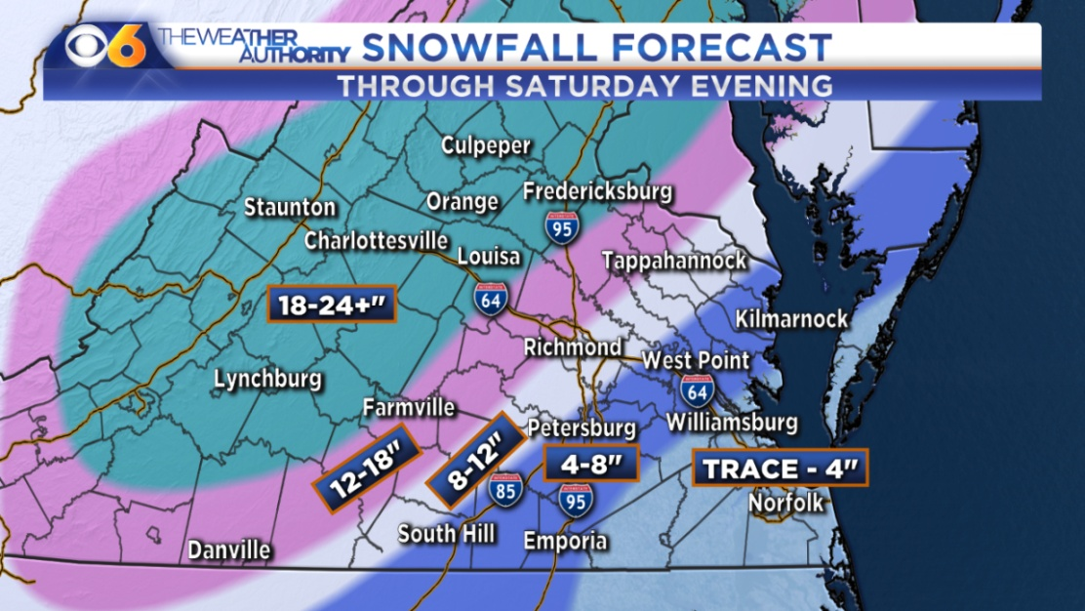
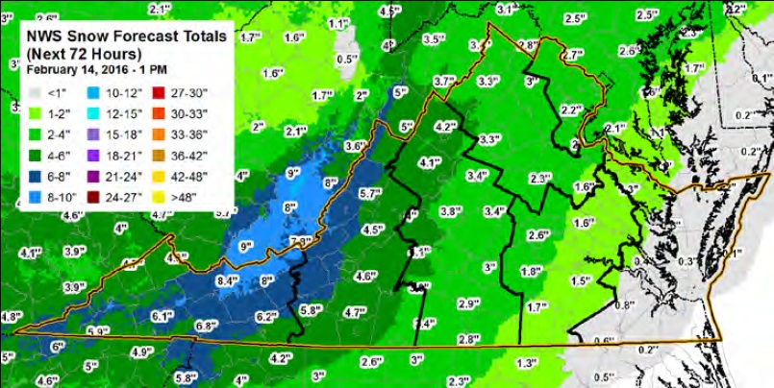
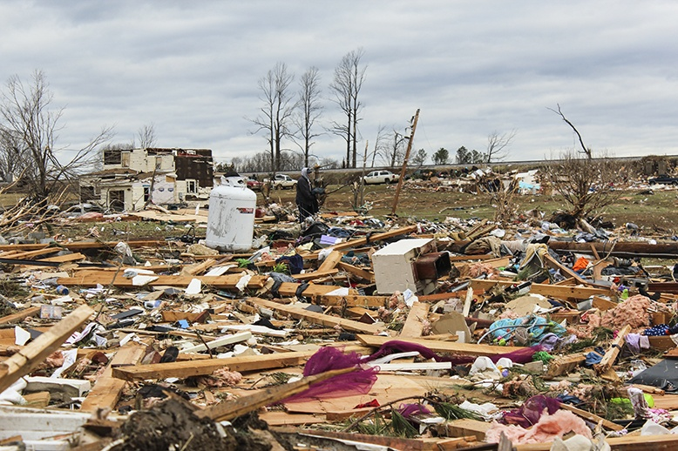
Winter 2016
⬅January 20
⬆February 15
⬅February 24

Slide 4
How’d Kate & Michelle get here?
Late February / Early March
Susan Mongold – in rotation as Recovery and Resilience Director
Facing Recovery for 2 events (Snow & Tornadoes)
Brought in group for Special Project
Kate Archie, Logistics Specialist
Ted Costin, Regional Support, West Division
Ben Nicely, Henrico County (former)
Michelle Oblinsky, Chesterfield County (former)
Matt Wall, Hazard Mitigation Branch Chief

Slide 5
Susan’s Big Idea
What functions need to be considered?
Health and Social Services
Housing
Volunteers
Who should be involved?
At State level
At Local level

Slide 6
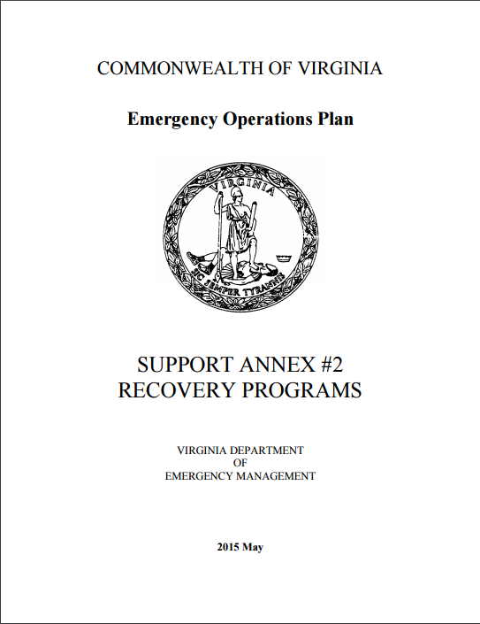
Susan’s Big Idea
Looked at a bunch of junk*:
COVEOP Recovery Annex
FEMA Region 3
Recovery Plan
National Disaster
Recovery
Framework
*Links to documents in resource list

Slide 7
Susan’s Big Idea
Talked about things to think about for recovery:
Housing
Economic impacts
Infrastructure
Environmental
Transportation

Slide 8
Typical Response Organization
Coordinator
PIO
Health & Safety Officer
Operations
Emergency Services Branch (ESF 4, 9, 10, 13 & 16)
Infrastructure Branch (ESF 1, 2, 3, 11 & 12)
Human Services Branch (ESF 6, 8 & 17)
PLANS
LOGS
FIN

Slide 9
Response Organization: Search & Rescue Operations Completed
Coordinator
PIO
Health & Safety Officer
Operations
Emergency Services Branch (ESF 4, 9, 10, 13 & 16)
Infrastructure Branch (ESF 1, 2, 3, 11 & 12)
Human Services Branch (ESF 6, 8 & 17)
PLANS
LOGS
FIN
Notes:
As response activities end and baseline indicators of recovery are met the EOC begins to stand down

Slide 10
Response Organization: Power Restored
Coordinator
PIO
Health & Safety Officer
Operations
Emergency Services Branch (ESF 4, 9, 10, 13 & 16)
Infrastructure Branch (ESF 1, 2, 3, 11 & 12)
Human Services Branch (ESF 6, 8 & 17)
PLANS
LOGS
FIN
Notes:
As response activities end and baseline indicators of recovery are met the EOC begins to stand down

Slide 11
Response Organization: Roads Cleared
Coordinator
PIO
Health & Safety Officer
Operations
Emergency Services Branch (ESF 4, 9, 10, 13 & 16)
Infrastructure Branch (ESF 1, 2, 3, 11 & 12)
Human Services Branch (ESF 6, 8 & 17)
PLANS
LOGS
FIN
Notes:
As response activities end and baseline indicators of recovery are met the EOC begins to stand down

Slide 12
Response Organization: Shelters Close
Coordinator
PIO
Health & Safety Officer
Operations
Emergency Services Branch (ESF 4, 9, 10, 13 & 16)
Infrastructure Branch (ESF 1, 2, 3, 11 & 12)
Human Services Branch (ESF 6, 8 & 17)
PLANS
LOGS
FIN
Notes:
As response activities end and baseline indicators of recovery are met the EOC begins to stand down

Slide 13
Response Organization: EOC Returns to Steady State
Coordinator
PIO
Health & Safety Officer
Operations
Emergency Services Branch (ESF 4, 9, 10, 13 & 16)
Infrastructure Branch (ESF 1, 2, 3, 11 & 12)
Human Services Branch (ESF 6, 8 & 17)
PLANS
LOGS
FIN

Slide 14
One Person Left to Process Project Worksheets
Coordinator
PIO
Health & Safety Officer
Operations
Emergency Services Branch (ESF 4, 9, 10, 13 & 16)
Infrastructure Branch (ESF 1, 2, 3, 11 & 12)
Human Services Branch (ESF 6, 8 & 17)
PLANS
LOGS
FIN

Slide 15
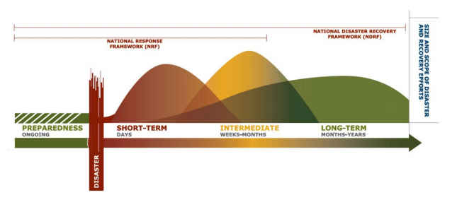
End Game:
Cost Recovery
VS
Community Recovery
Notes:
Current process moves from addressing the restoration of services to cost recovery

Slide 16
Baseline Recovery
Restoration of:
Services
Facilities
Infrastructure
Documentation of:
Damage
Costs
Notes:
Shelters Closed
Power On
Roads Cleared
Disaster Cost Recovery Reimbursements Maximized

Slide 17
Beyond the Baseline (the Hard Stuff)
Who is going to address long term housing needs?
Who is helping the community identify and adapt to changed economic conditions?
Who is working to develop new or strengthened economic drivers?
Who is making sure the community uses reconstruction to facilitate economic, housing, or hazard mitigation strategies?
Etc…..

Slide 18
What Does It Look Like?
Typical Response Organization
Recovery Organization
Coordinator
PIO
Health & Safety Officer
Operations
Emergency Services Branch (ESF 4, 9, 10, 13 & 16)
Infrastructure Branch (ESF 1, 2, 3, 11 & 12)
Human Services Branch (ESF 6, 8 & 17)
PLANS
LOGS
FIN

Slide 19
Transition ESF to RSF
ESF
RSF

Slide 20
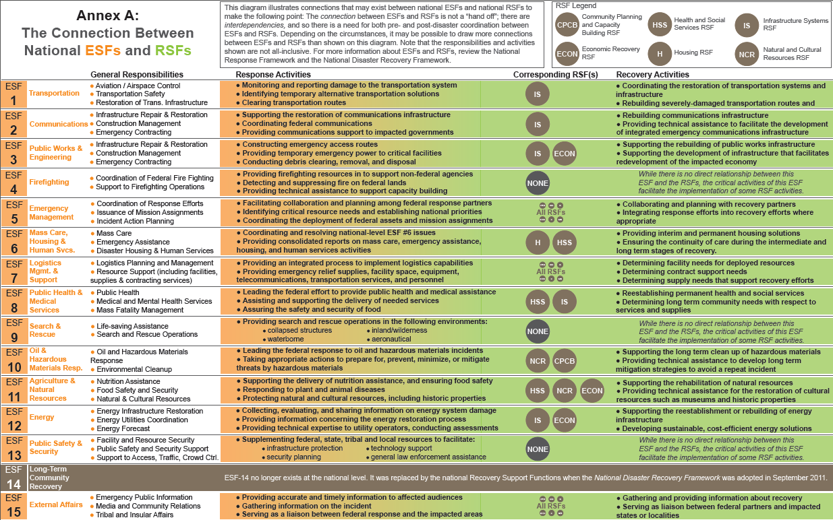
The Connection

Slide 21
RSF Descriptions: CPCB
Community Planning and Capacity Building is responsible for identifying, assessing, and providing resources in support to post-disaster community planning and capacity building in the impacted area. This is accomplished through the identification of gaps in impacted community’s ability to take on planning and capacity building initiatives.
Relates to overall objectives and measures for the community
What do you want to accomplish?
What areas are impacted?
Ties back to Community Mitigation Plan or Comprehensive Plan

Slide 22
RSF Descriptions: ECON
Economic Recovery is responsible for identifying, assessing, and providing resources in support to the recovery of the economy in the impacted area.
Community Planning
Cash Flow
Business Resumption
Finance and Insurance
Workforce Development
Economic Development
Small Business
Marketing & Communications
Assessment & Evaluation

Slide 23
RSF Descriptions: HSS
Health and Social Services is responsible for identifying, assessing, and providing resources in support to the recovery of health and social services in the impacted area.
Public Health
Health Care Services and Impacts
Behavioral Health Impacts
Environmental Health Impacts
Food Safety and Regulated Medical Products
Long-Term Health Issues Specific to Responders
Social Services Impacts
Referral to Social Services / Disaster Case Management
Schools and Children in Disasters

Slide 24
RSF Descriptions: H
Housing is responsible for identifying, assessing, and providing resources in support to the recovery of the housing in the impacted area. Housing recovery may include short-, intermediate-, and long-term solutions.

Slide 25
RSF Descriptions: IS
Infrastructure is responsible for identifying, assessing, and providing resources in support to the recovery of the infrastructure systems in the impacted area. This is accomplished through the identification of gaps in the Infrastructure systems core capability.
Chemical
Commercial Facilities
Communications
Critical Manufacturing
Dams/Levees
Defense Industrial
Base
Emergency Services
Energy
Financial Services
Food and Agriculture
Government Facilities
Healthcare / Public Health
Information Technology
Nuclear Reactors / Materials
Transportation Systems
Water and Wastewater

Slide 26
RSF Descriptions: NCR
Natural and Cultural Resources is responsible for identifying, assessing, and providing resources in support to the recovery of natural and cultural resources in the impacted area.
Water / Watersheds
Environmental Compliance
Historic Preservation
Cultural Resources
Land Management
Tribes / Tribal Lands
Fish / Wildlife / Habitat

Slide 27
Typical Response Organization
Coordinator
PIO
Health & Safety Officer
Operations
Emergency Services Branch (ESF 4, 9, 10, 13 & 16)
Infrastructure Branch (ESF 1, 2, 3, 11 & 12)
Human Services Branch (ESF 6, 8 & 17)
PLANS
LOGS
FIN

Slide 28
Community Recovery Organization
Coordinator
PIO
Health & Safety Officer
Recovery
(RSF CPCB)
Emergency Services Branch (ESF 4, 9, 10, 13 & 16)
Infrastructure Branch
(RSF IS, ECON, HSS, NCR)
Human Services Branch (RSF H, HSS)
PLANS
LOGS
FIN

Slide 29
Our Template
HSS
Housing
VAL
Support
VDH
VDBHDS
DOE
DSS
VDEM
DHCD
DSS
VDEM
PIO
Logistics
Planning
Finance/Admin
CPCB
VDEM DRRO
East/West Division Directors
Recovery Support Functions-
State Side
VEST
State Coordinator
Locality
Recovery Support Functions-
Local Side
County Administrator
CPCB
Local EM
COOP: IMT, Team Rubicon
HSS
Housing
VAL
Support
District Emergency Coordinators
CSBS
Local DSS
Schools
Local Community Development Office
Local DSS
Long Term Recovery Task Force
PIO
Logistics
Planning
Finance/Admin

Slide 30
VDEM/State Response
Mapped this new “template” organization model against each of the 3 communities
Each community had their own challenges and priorities
Challenges and priorities used to determine what RSF elements were stood up, in what order, and what players should be at the table

Slide 31
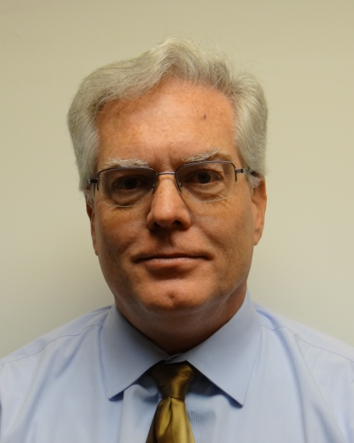
VDEM Aiming Beyond the Baseline
Recovery & Resilience Division
developing pre-event status and post-event operations evaluative tool for training & needs identification
contact for recovery planning assistance
Matthew Wall
Acting Director, Recovery & Resilience Division
State Hazard Mitigation Officer
804-897-9973
Matthew.Wall@vdem.virginia.gov

Slide 32
VDEM Aiming Beyond the Baseline
Training, Education and Exercise Division
constantly in process of identifying new courses for development
contact with requests and/or suggestions
Donna Taylor
Academic Support Coordinator
Training, Education and Exercise Division
Donna.Taylor@VDEM.Virginia.gov

Slide 33
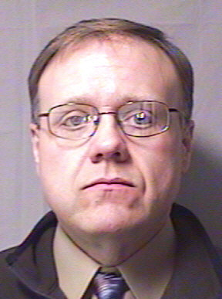
VDEM Aiming Beyond the Baseline
Training, Education and Exercise Division
Incorporate recovery into exercises
Exercise your recovery plan
Aaron L. Kesecker, MEP
Exercise Program Manager
Training, Education and Exercise Division
804-897-9985
Aaron.KeseckerAVDEM.Virginia.gov

Slide 34
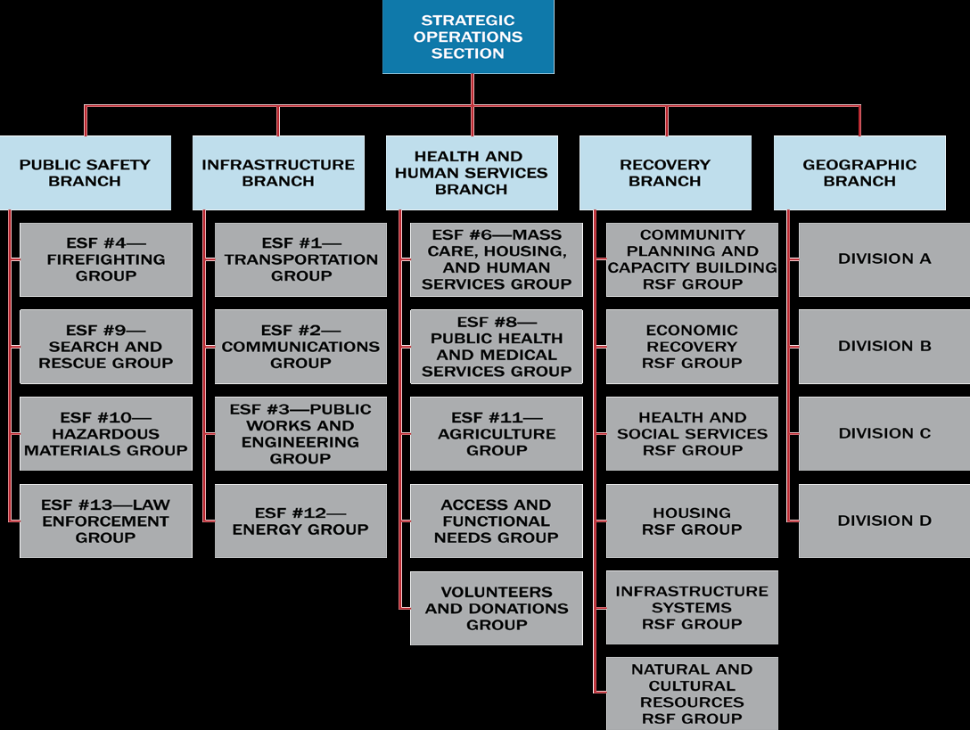
Steps Forward
VEST restructure
ESF to RSF (Based on proposed NIMS)

Slide 35
New VEST Organization
VEST Coordinator
Assistant
OPS / REC
PLANS
LOGS
FIN
Regional Support Branch
Emergency Services Branch
Infrastructure Branch
Human Services Branch
Current Plan Unit
Future Plan Unit
Situation Unit
Documents
Planning Specialist
Demob Specialist
Recovery Specialist
GIS
Social Media Monitor / Specialist
IT Unit
Resource Management Unit
Accommodations
Transportation
Personnel
Budget
Time / Workers Comp
Health & Safety Officer
Information Collection
Essential Elements of Information
Trends
East
West
ESF 4, 9, 10, 13 & 16
ESF 1, 2, 3, 11 & 12
ESF 6, 8 & 17
RSF IS, ECON, HSS, NCR
RSF H, HSS
PIO
Procurement
Mutual Aid
Support Unit
August 2016

Slide 36
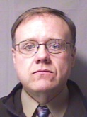
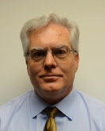
Resources
COVEOP Recovery Annex
http://www.vaemergency.gov/webfm_send/1059/COVEOP_2012_SA_2_Recovery_Programs_May_2015.pdf
FEMA Region 3 Recovery Plan
Link to presentations on VEMA homepage
http://www.vemaweb.org/
National Disaster Recovery Framework
http://www.fema.gov/media-library-data/1466014998123-4bec8550930f774269e0c5968b120ba2/National_Disaster_Recovery_Framework2nd.pdf
Donna Taylor
Academic Support Coordinator
Donna.Taylor@VDEM.Virginia.gov
Aaron L. Kesecker
Exercise Program Manager
804-897-9985
Aaron.KeseckerAVDEM.Virginia.gov
Matthew Wall
Acting Director, Recovery & Resilience Division
804-897-9973
Matthew.Wall@vdem.virginia.gov

Slide 37
Questions?

